Slide 1

6th Grade Accelerated Math
Unit 2, Lesson 5 Using Operations to Solve Real-World Problems – Part 2 Volume 1, pg. 60

Slide 2


Benchmark
MA.6.NSO.2.3 Solve multi-step, real-world problems involving any of the four operations with positive multi-digit decimals or positive fractions, including mixed numbers.
volume 1, pg. 60

Slide 3
Integrated Mathematical Thinking and Reasoning Standards
MA.K12.MTR.5.1 Use patterns and structure to help understand and connect mathematical concepts.
MA.K12.MTR.7.1 Apply mathematics to real-world contexts.
volume 1, pg. 60

Slide 4

Learning Target
I can solve real-world problems with up to two steps using decimals or fractions.
volume 1, pg. 60

Slide 5

Warm-Up
volume 1, pg. 61

Slide 6
2.5.1 Warm-Up: Two Questions and One Wonder
Ky-ree, a firefighter in Los Angeles, budgets his paycheck.
volume 1, pg. 61

Slide 7
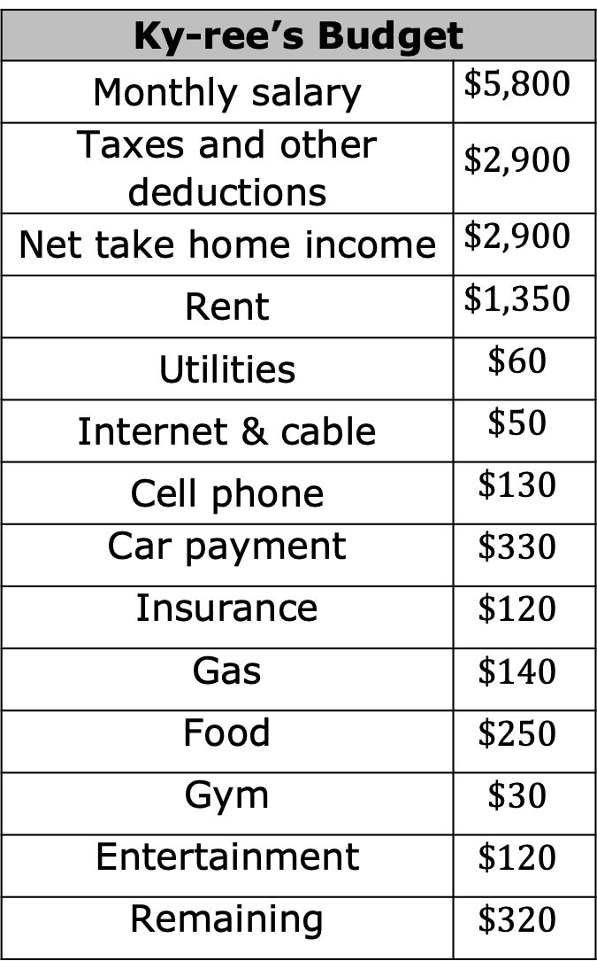
Ky-ree’s Budget
Monthly salary | $$\$5,800$$
Taxes and other deductions | $$\$2,900$$
Net take home income | $$\$2,900$$
Rent | $$\$1,350$$
Utilities | $$\$60$$
Internet & cable | $$\$50$$
Cell phone | $$\$130$$
Car payment | $$\$330$$
Insurance | $$\$120$$
Gas | $$\$140$$
Food | $$\$250$$
Gym | $$\$30$$
Entertainment | $$\$120$$
Remaining | $$\$320$$
List two questions you have about Ky-ree’s budget.
List one thing you wonder about Ky-ree’s budget.
volume 1, pg. 61

Slide 8

Guided Instruction
volume 1, pg. 61

Slide 9
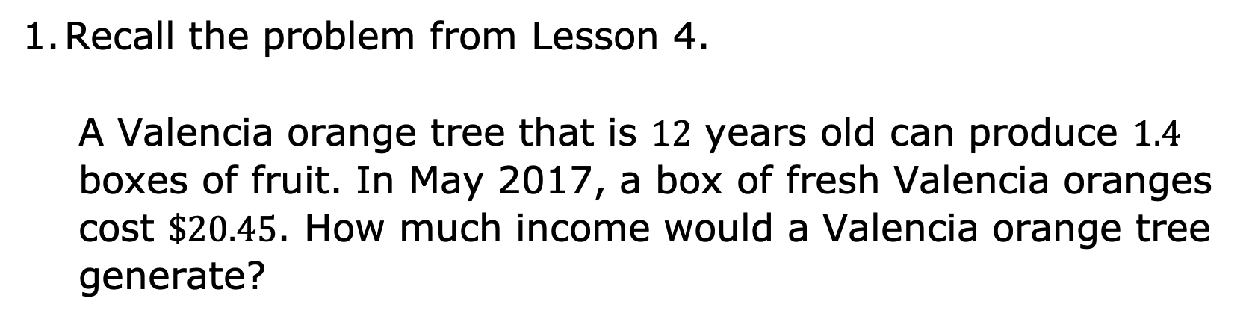
2.5.2 Guided Instruction: Real-World Contexts About Finances
Income is the amount of money received.
Recall the problem from Lesson 4.
A Valencia orange tree that is $12$ years old can produce $1.4$ boxes of fruit. In May 2017, a box of fresh Valencia oranges cost $\$20.45$. How much income would a Valencia orange tree generate?
volume 1, pg. 61

Slide 10
Finance is the management of money.
Daniel owns a Valencia orange grove. Choose other items from the list that he should consider as a part of his finances.
The taxes he pays on the property.
The amount of money he has in the bank.
The cost of taking care of the orange grove.
volume 1, pg. 61

Slide 11
Use the words in the word bank to complete each statement.
______________ or _____________ describe money that is spent.
____________ are the amount of money that is paid to the government.
A _____________ is the amount of money placed in a bank account.
A ____________ is the amount of money removed from a bank account.
_____________ and _____________ are types of bank accounts.
Word Bank
withdrawal | checking | costs | deposit
expenses | savings | taxes
volume 1, pg. 62

Slide 12
An investment is when the initial amount of money, known as the principal, earns more money, known as the return, over time.
For each financial transaction, write the mathematical operation that is most commonly associated with it.
Financial Transaction | Mathematical Operation
costs
deposit
expenses
income
taxes
withdrawal
return on an investment
volume 1, pg. 62

Slide 13
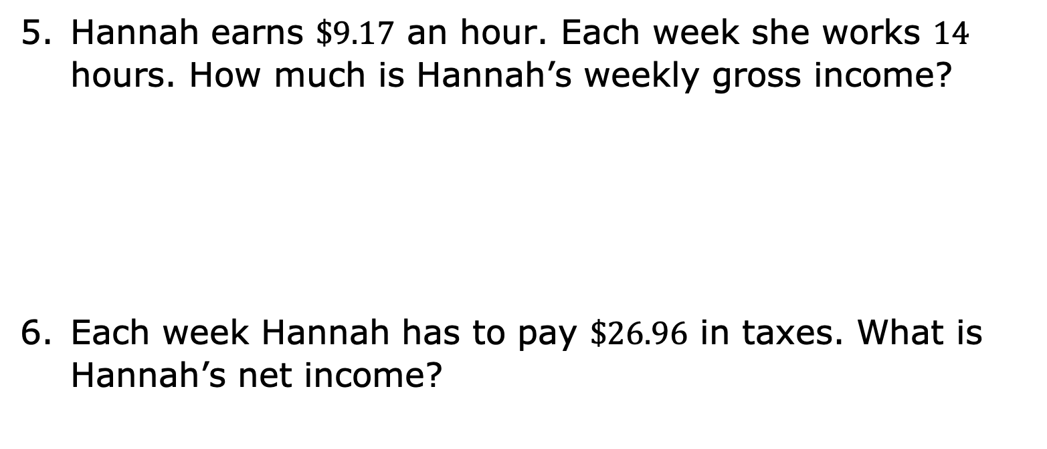
Gross income is the amount of income that is earned.
Hannah earns $\$9.17$ an hour. Each week she works $14$ hours. How much is Hannah’s weekly gross income?
Each week Hannah has to pay $\$26.96$ in taxes. What is Hannah’s net income?
Net income is the amount of income that is earned after expenses and taxes are deducted.
volume 1, pg. 62

Slide 14

Guided Practice
volume 1, pg. 63

Slide 15

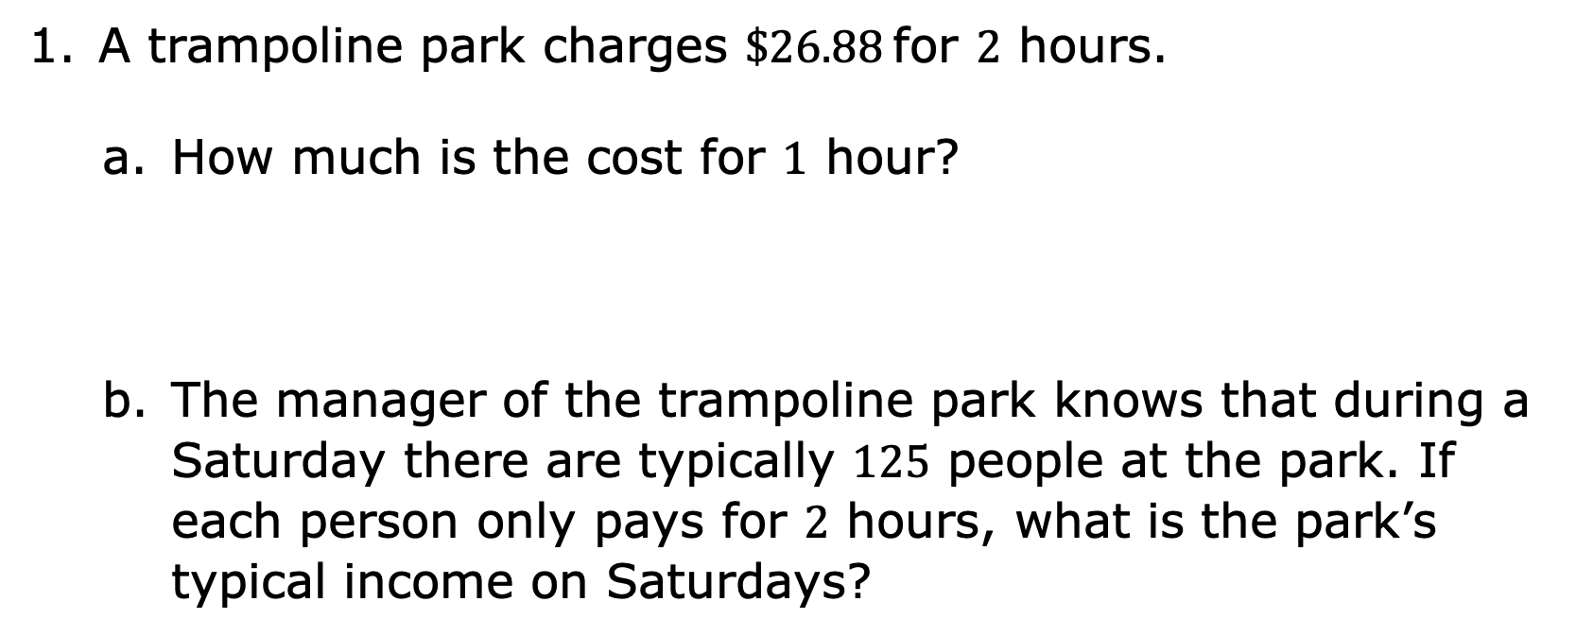
2.5.3 Guided Practice: Solving Real-World Finance Problems
A trampoline park charges $\$26.88$ for $2$ hours.
How much is the cost for $1$ hour?
The manager of the trampoline park knows that during a Saturday there are typically $125$ people at the park. If each person only pays for $2$ hours, what is the park’s typical income on Saturdays?
volume 1, pg. 63

Slide 16
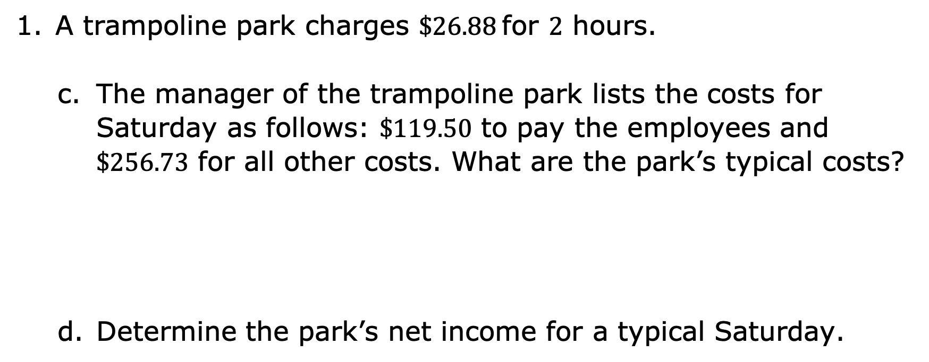
A trampoline park charges $\$26.88$ for $2$ hours.
The manager of the trampoline park lists the costs for Saturday as follows: $\$119.50$ to pay the employees and $\$256.73$ for all other costs. What are the park’s typical costs?
Determine the park’s net income for a typical Saturday.
volume 1, pg. 63

Slide 17

Emmanuel invested $\$12,500$ into the stock market. His return, the money he earned on his investment, was $\$281.25$ for each of the first three quarters of the year. He combines his returns with his initial investment. How much does Emmanuel have invested after the third quarter of the year?
volume 1, pg. 63

Slide 18
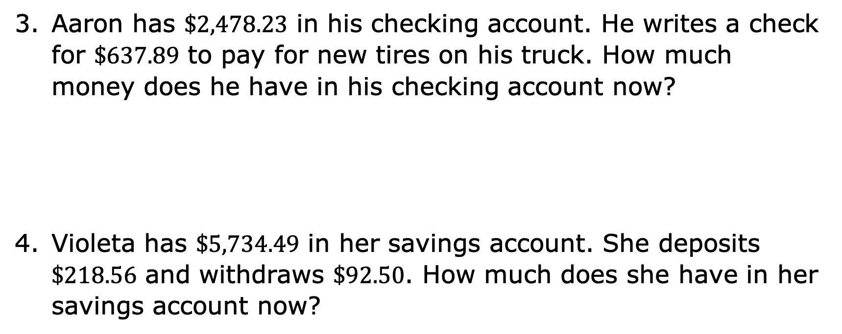
Aaron has $\$2,478.23$ in his checking account. He writes a check for $\$637.89$ to pay for new tires on his truck. How much money does he have in his checking account now?
Violeta has $\$5,734.49$ in her savings account. She deposits $\$218.56$ and withdraws $\$92.50$. How much does she have in her savings account now?
volume 1, pg. 63

Slide 19

Wrap-Up
volume 1, pg. 64

Slide 20
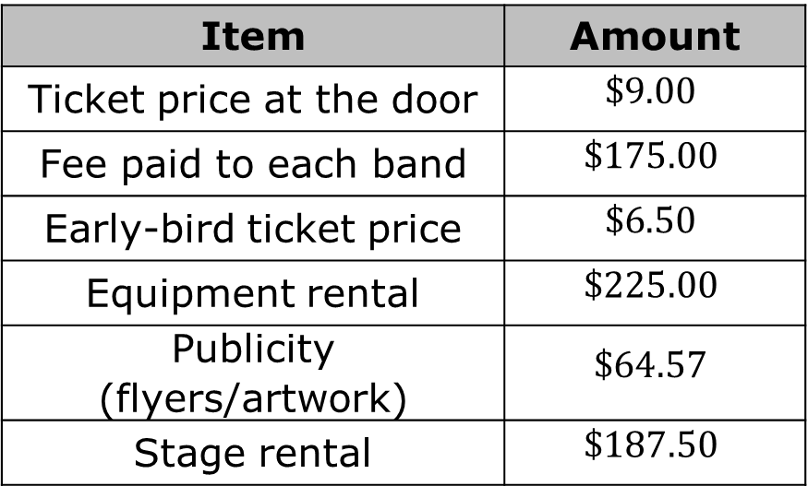
2.5.4 Wrap-Up: Ticket Out the Door
Mishka is planning to host a music festival to raise funds for a local food bank. Her budget is shown.
In order to find the gross income for the music festival, I need to know ________________________ and __________________________________.
Item | Amount
Ticket price at the door | $$\$9.00$$
Fee paid to each band | $$\$175.00$$
Early-bird ticket price | $$\$6.50$$
Equipment rental | $$\$225.00$$
Publicity (flyers/artwork) | $$\$64.57$$
Stage rental | $$\$187.50$$
volume 1, pg. 64

Slide 21
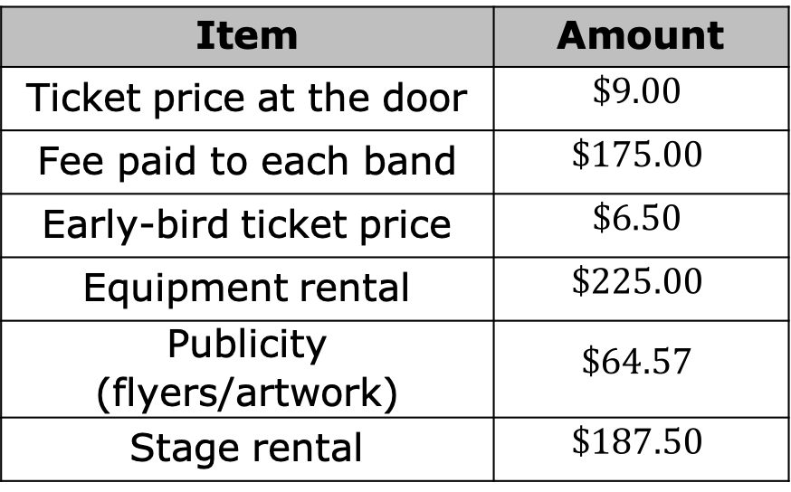
Item | Amount
Ticket price at the door | $$\$9.00$$
Fee paid to each band | $$\$175.00$$
Early-bird ticket price | $$\$6.50$$
Equipment rental | $$\$225.00$$
Publicity (flyers/artwork) | $$\$64.57$$
Stage rental | $$\$187.50$$
List the items in Mishka’s budget that are expenses.
volume 1, pg. 64

Slide 22

Item | Amount
Ticket price at the door | $$\$9.00$$
Fee paid to each band | $$\$175.00$$
Early-bird ticket price | $$\$6.50$$
Equipment rental | $$\$225.00$$
Publicity (flyers/artwork) | $$\$64.57$$
Stage rental | $$\$187.50$$
If Mishka had a gross income of $\$1,166.50$ and expenses totaling $\$827.07$, what is her net income for the music festival?
volume 1, pg. 64

